Slide 1
Course Name: Database Management System
Course Code: CS116
Dr. Praveen Kantha

Slide 2
Introduction to data models
A Data Model gives us an idea that how the final system will look like after its complete implementation.
A Data Model in DBMS is the concept of tools that are developed to summarize the description of the database.
It defines how the logical structure of a database is modeled
A Data Model is a collection of conceptual tools for describing:
Data
Data relationships
Data semantics and
Consistency constraints

Slide 3
Introduction to data models
It describes the design of a database at each level of data abstraction.
It defines how data is connected to each other and how they are processed & stored inside the system
We focus in this course
We focus in this course

Slide 5
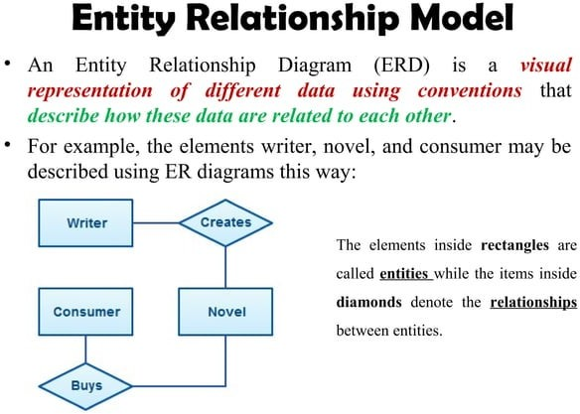

Slide 6
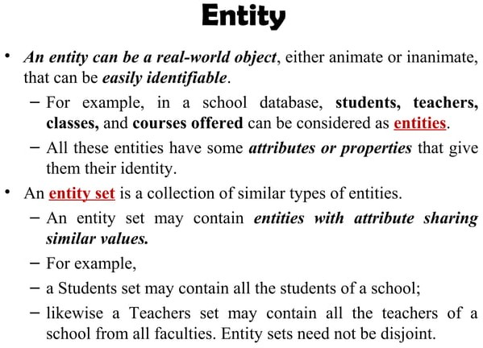

Slide 7
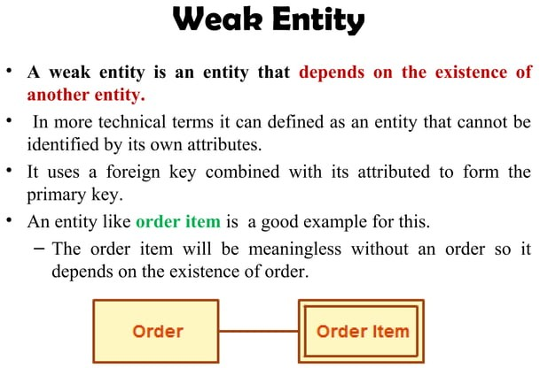

Slide 8
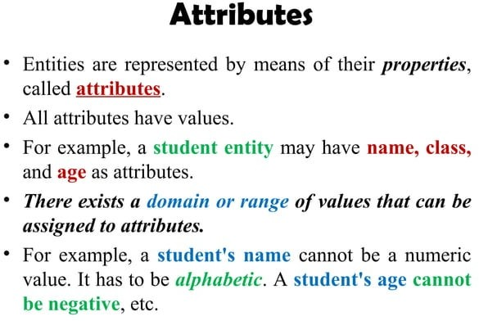

Slide 9
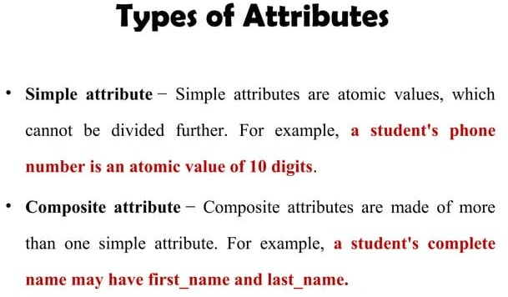

Slide 10
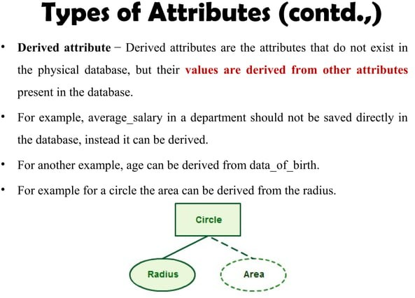

Slide 11
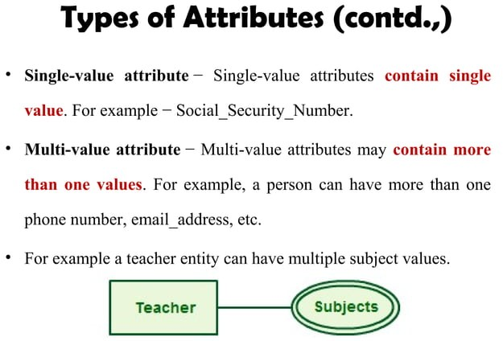

Slide 12
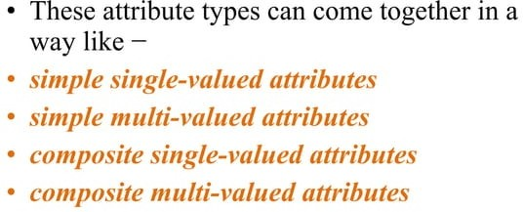

Slide 13
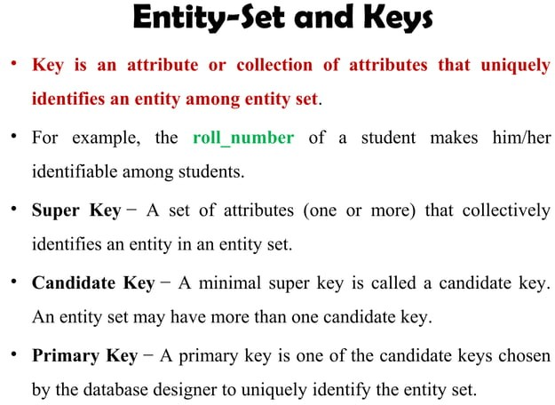

Slide 14
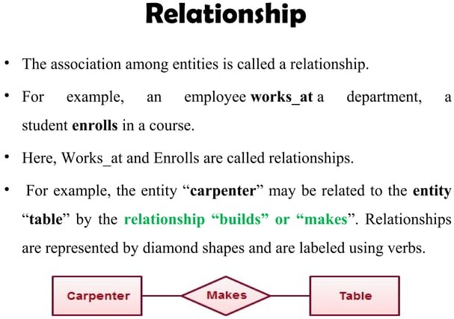

Slide 15
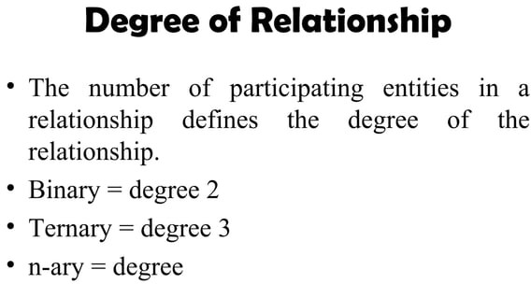

Slide 16
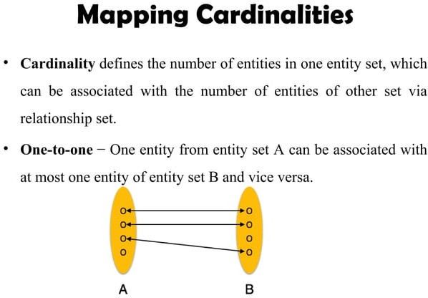

Slide 17
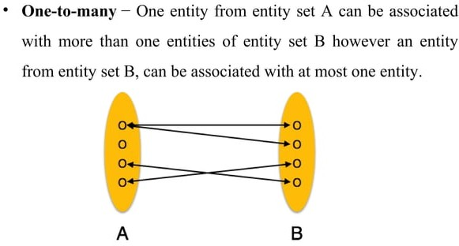

Slide 18
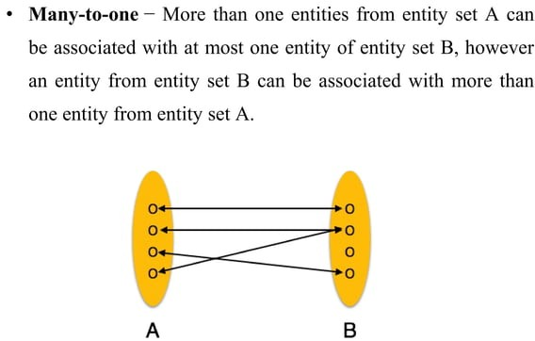

Slide 19
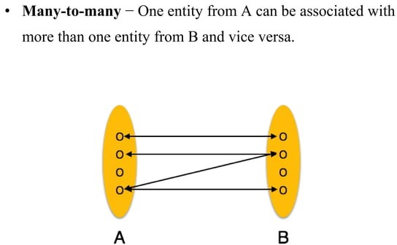

Slide 20
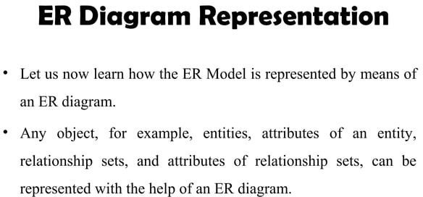

Slide 21
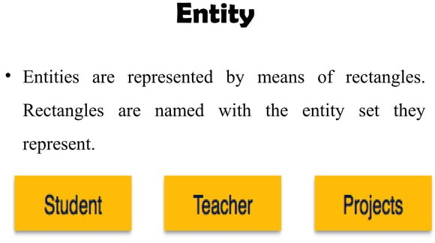

Slide 22
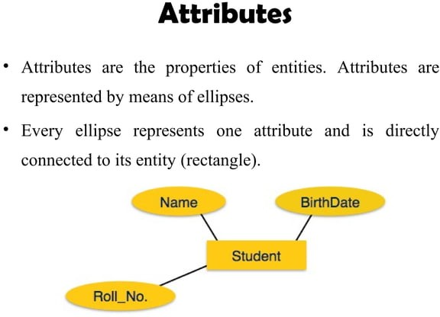

Slide 23
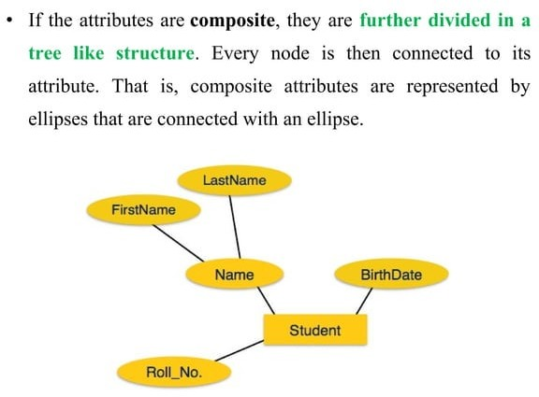

Slide 24
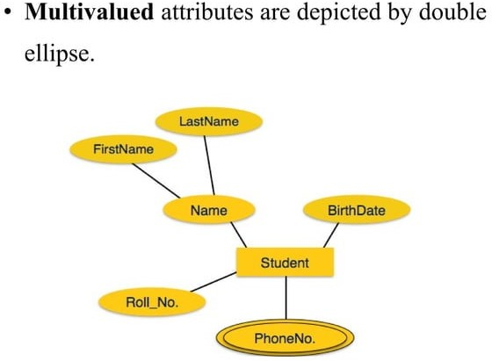

Slide 25
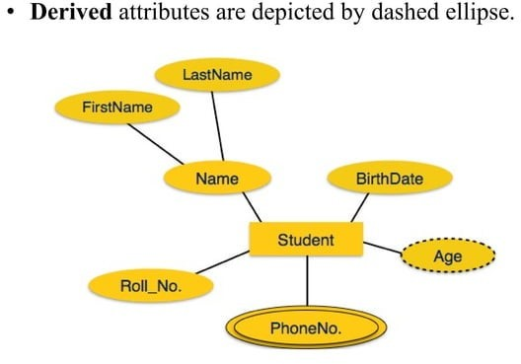

Slide 26
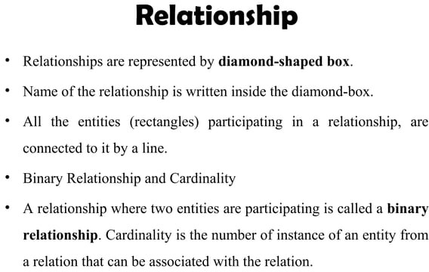

Slide 27
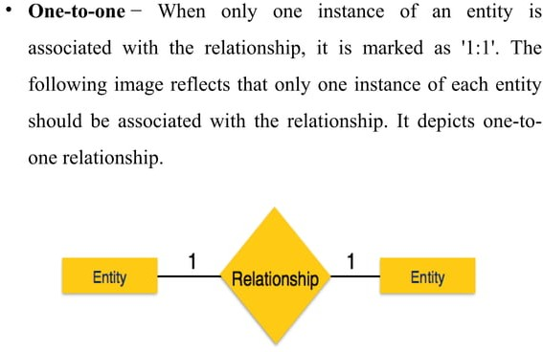

Slide 28
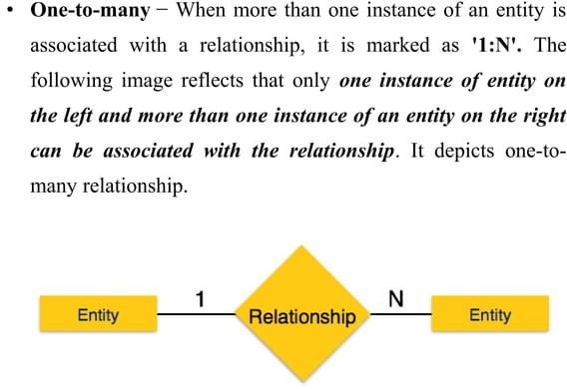

Slide 29
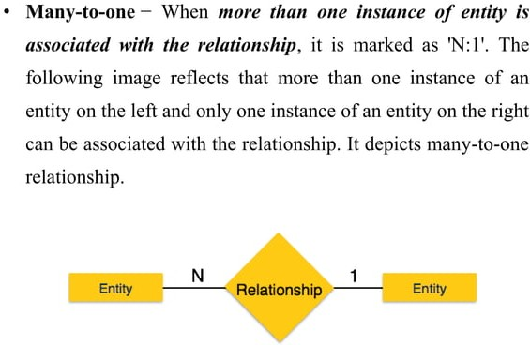

Slide 30
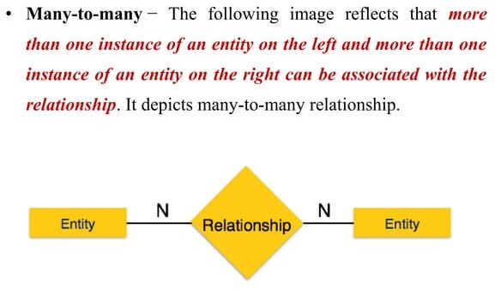

Slide 31
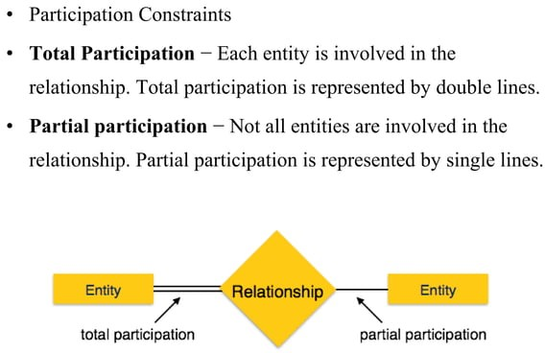

Slide 32
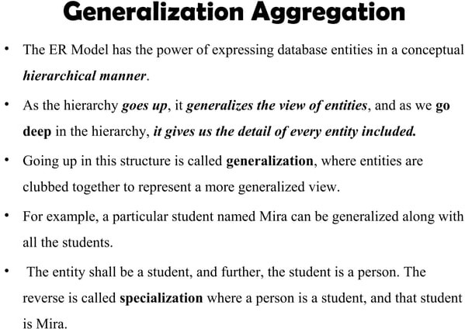

Slide 33
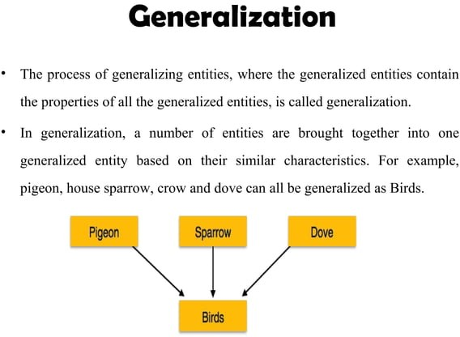

Slide 34
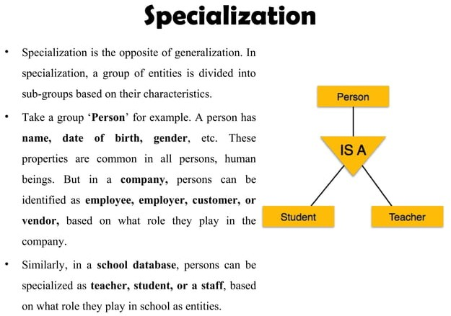

Slide 35
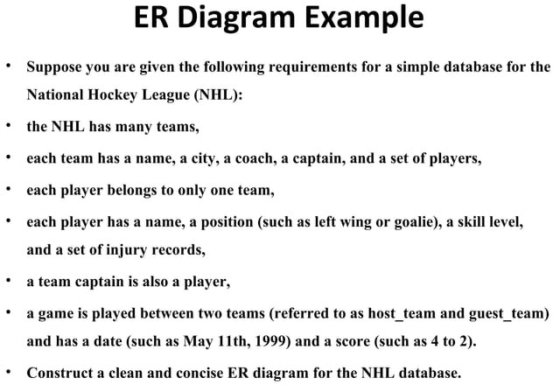

Slide 36
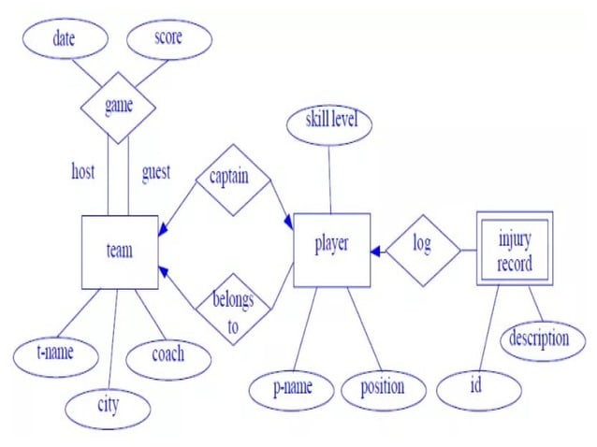

Slide 37
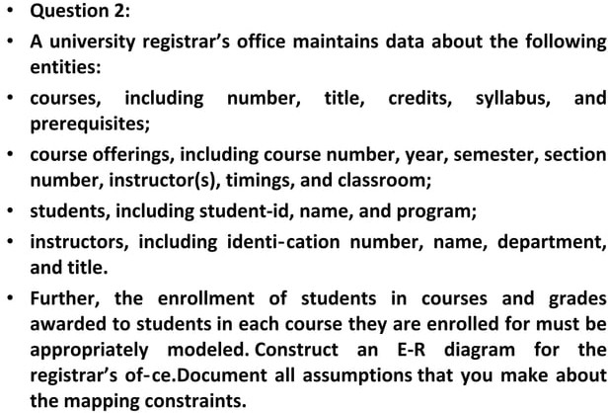

Slide 38
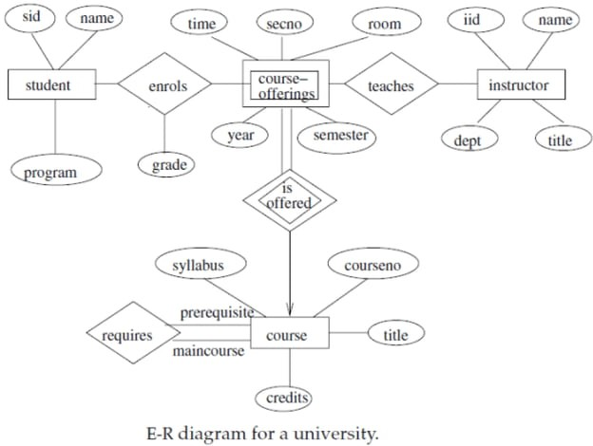

Slide 39
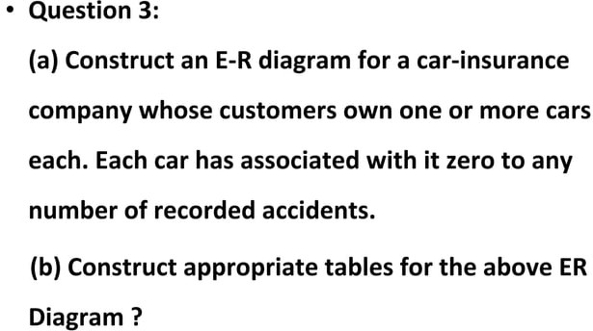

Slide 40
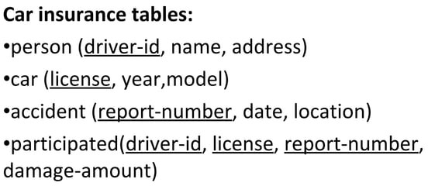

Slide 41
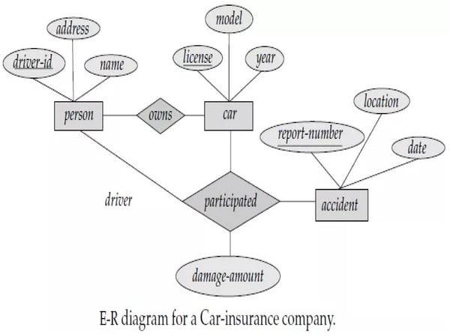

Slide 42
Introduction to Relational Model
The most widely used model by commercial data processing applications
It uses a collection of tables for representing data and the relationships among those data
Data is stored in tables called Relations
Each table is a group of columns and rows, where the column represents an attribute of an entity and the rows represent records (or tuples).
Attribute or field: Each column in a relation is called an attribute. The values of the attribute should be from the same domain.

Slide 43
Introduction to Relational Model
For example: we have different attributes of the student like Student_Id, Student_Name, Student Age, etc.
Tuple or Record: Each row in the relation is called a tuple. A tuple defines a collection of attribute values. So each row in a relation contains unique values.
For example: each row has all the information about any specific individual like the first row has information about student Ashish.
This model was initially described by Edgar F. Codd, in 1969.

Slide 44
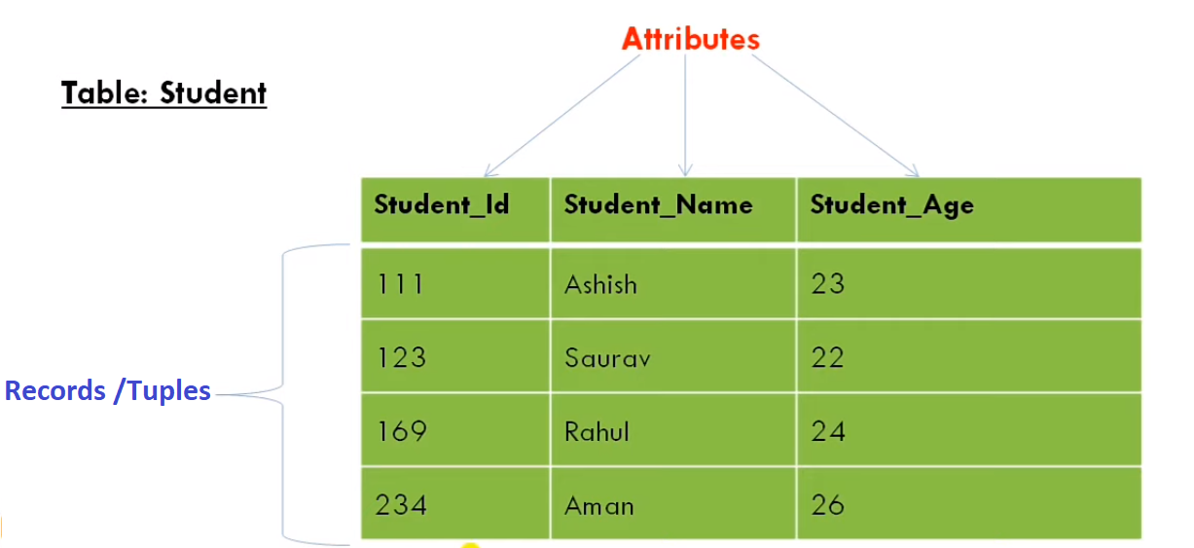
Example: Relational Model

